Slide 1
Fulfillment Rate Analysis in a Beauty Supply Chain
Identifying potential drivers behind low fulfillment performance
By Ahsan Mubarak

Slide 2
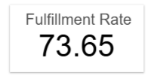
Business Context & Objective
Business Context
Fulfillment Rate is one of the key operational and efficiency KPIs in supply chain management. It measures how successfully a company fulfills customer orders.
In this project, the company's fulfillment rate is 73.65%, which is likely considered low based on industry benchmarks.
Common causes of low fulfillment include low utilization rates, stock issues, shipping delays, and long lead times.
Objective This analysis aims to identify the most likely contributing factors based on the available data.
Disclaimer: Fulfillment Rate in this analysis is calculated using the Availability column as a proxy for actual shipped items, since detailed shipping data is not available.

Slide 3
Dataset Overview
Dataset: Supply Chain Data
Source: Kaggle - Supply Chain Data
Supply chain analytics plays a crucial role in data-driven decision-making across industries such as manufacturing, retail, healthcare, and logistics.
This dataset includes:
Order quantities
Stock levels
Availability
Lead time
Shipping time

Slide 4
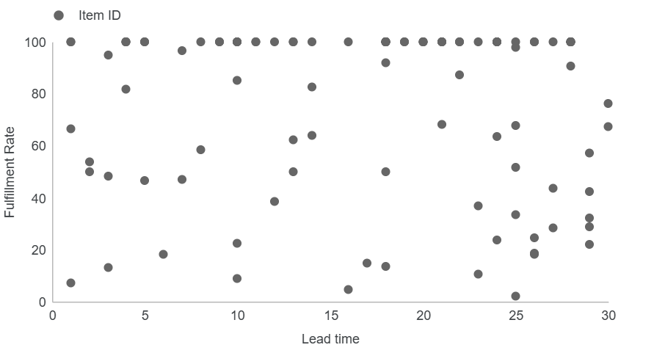
No Clear Relationship Between Lead Time and Fulfillment
Insight:
The scatter plot shows no clear trend or direction.
Correlation between Fulfillment Rate and Lead Time is weak and statistically insignificant.
Indicates that lead time is unlikely to be a major factor affecting fulfillment.

Slide 5
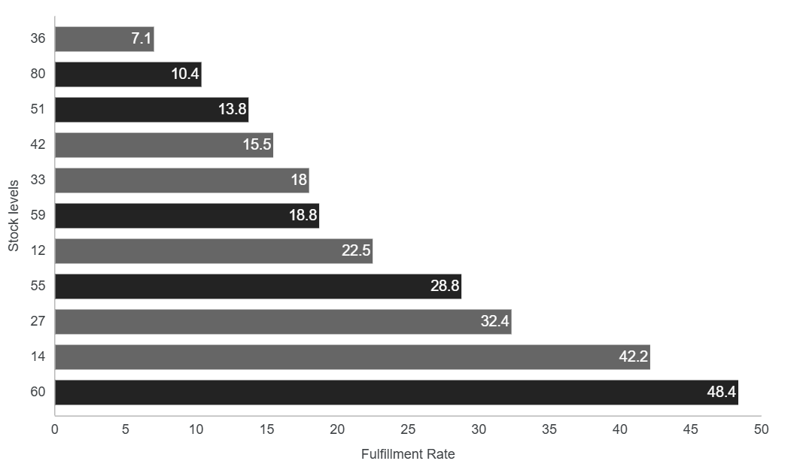
High Stock Levels Don’t Ensure High Fulfillment
Insight:
No strong pattern observed between stock levels and fulfillment rate.
Some high stock levels (80, 60, 59, 55) still result in low fulfillment rates.
Notably, stock level 36 has the lowest fulfillment rate (7.1%), and stock level 80 is also among the lowest (10.4%).

Slide 6
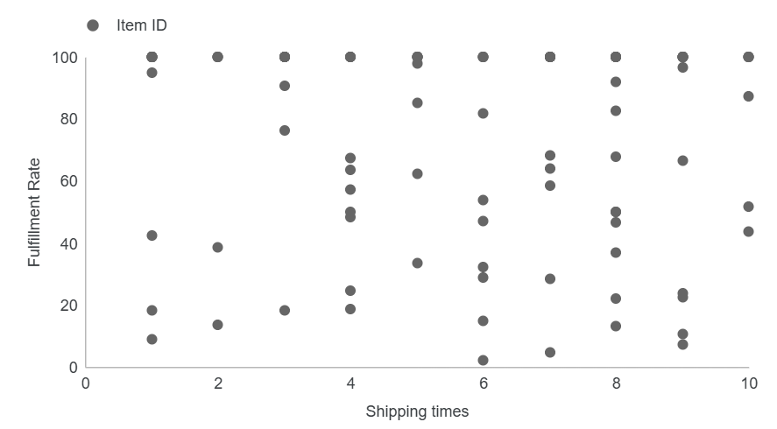
Shipping Time Also Fails to Predict Fulfillment
Insight:
As with lead time, there’s no strong correlation between shipping time and fulfillment.
Data points are scattered without a clear trend.
Indicates that shipping delays may not be the primary driver of low fulfillment.

Slide 7
What We Know So Far
No strong relationship was found between fulfillment rate and stock levels, lead time, or shipping time.
Products with high stock still show poor fulfillment performance.
Lead time and shipping time show correlation values below 1%.
A likely cause could be low warehouse or order processing utilization, which couldn’t be tested due to data limitations.
Further investigation is needed to confirm this hypothesis and guide operational improvements.

